Slide 1
GOVERNANCE
SODA Foundation is overseen by the Governing Board and supported by the Technical Steering Committee (TSC), End User Advisory Committee (EUAC) and Outreach Committee (OC).
Ecosystem Philosophy
SODA
ARM
AI for Data Infrastructure
Open Storage
Data Lakes for Big Data & AI

Slide 2
SODA BOARD AND COMMITTEES
GOVERNING BOARD
YOSHIYA ETOU, FUJITSU, LF FELLOW (ADVISOR)
STEVEN TAN, FUTUREWEI (CHAIRMAN)
XIN ZHONG, CHINA UNICOM
(TREASURER)
KEI KUSUNOKI, NTT COMMUNICATION
SHINYA HAMONO, FUJITSU
ANJANEYA REDDY CHAGAM, INTEL
YUJI YAZAWA, TOYOTA MOTOR CORP
(VICE-CHAIR)
RAKESH JAIN, IBM
TECHNICAL STEERING COMMITTEE
Rakesh Jain, IBM (Co-Chair)
Kei Kusunoki, NTT Communications (Co-Chair)
Xin Zhong, China Unicom
Masanori Itoh, Toyota
Vinod E, Wipro
Hiroki Kimura, Fujitsu
Yusuf Yildiz, Linbit
Shenglin Wu, ProphetStor
Kiran Mova, MayaData
Prashant Mishra, Click2Cloud
Sanil Kumar, Huawei
END USER ADVISORY COMMITTEE
Yuji Yazawa, Toyota Motor Corp (Chair)
Wim Jacobs, KPN
Tomoko Kondo, Softbank
Brian Dunlap, Southwest Airlines
Shinya Tsunetmatsu, GMO Pepabo
Yusuke Sato, Yahoo Japan
Cosimo Rosetti, Vodafone
Terada Mitchitaka, Internet Initiative Japan
Michiharu Nakazawa, Sakura Internet
Zhan Shu, China Construction Bank Fintech
Wei Rao, China Railways
OUTREACH COMMITTEE
Lawrence Lai, Futurewei (Chair)
Shane Wang, Intel (Vice-Chair)
Greg Eckert, Linbit (N. America)
Trevor Phillipe, MayaData (N. America)
Steffano Maffuli, Scality (N. America, Europe)
Masahiro Itoh, Individual (Japan)
Shinya Hamano, Fujitsu (Japan)
Shimada Ichiro, Sony (Japan)
Jiaming Pan, eHualu (China)
Thomas Kozlowski, Linbit (Europe)
Sai Nath, Wipro (India)
Pradipta, IBM (India)
Vivek, Microsoft (India)
Ecosystem Philosophy
SODA
ARM
AI for Data Infrastructure
Open Storage
Data Lakes for Big Data & AI

Slide 3
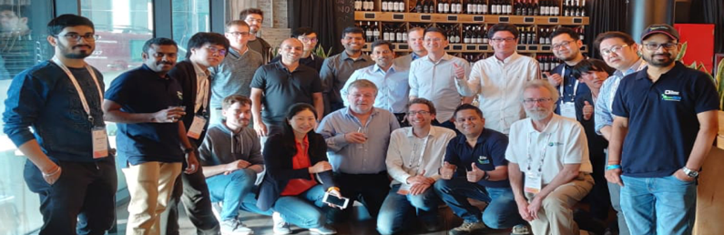
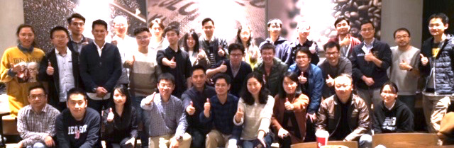
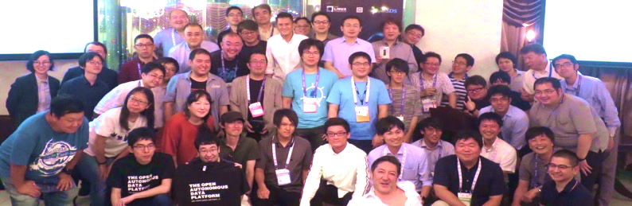
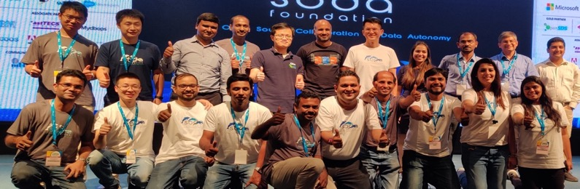
SODA communities are slowly growing around the world with strong communities in Japan, China, and India holding regular meetups. Our goal is to grow in Europe and N. America in the near future.
SODA GLOBAL COMMUNITIES
EUROPE - KubeCon Barcelona 2019
CHINA - KubeCon Shanghai 2019
JAPAN - CloudNativeDays Tokyo 2019
INDIA - Open Source India, Bengaluru 2019
Ecosystem Philosophy
SODA
ARM
AI for Data Infrastructure
Open Storage
Data Lakes for Big Data & AI

Slide 4
UPCOMING EVENTS
Forums and Sponsorships
Q3
SODA Launch - OSS N. America (virtual) 6/29–7/2 (Keynote + SODA Forum + Talk)
SODA Day at Microsoft, Bengaluru 8/20
Cloud Native Days, Tokyo 9/8-9/9
SODA Forum Europe - K8S Day, London 9/3-9/4
SODA Forum Japan - OSS Japan 9/15-9/16
SNIA SDC, Santa Clara 9/21-9/24
Q4
SODA Forum India – Open Source India 10/8-10/9
Open Infrastructure Summit, Berlin 10/19-10/23
SNIA SDC India, Bengaluru 10/20
OSS Europe, Dublin 10/26-10/28
SODA Forum US – KubeCon Boston 11/17-11/20
LF Member Forum, Tokyo 12/3
Webinars and Meetups
Japan, China, India - Q3 and Q4
Ecosystem Philosophy
SODA
ARM
AI for Data Infrastructure
Open Storage
Data Lakes for Big Data & AI

Slide 5
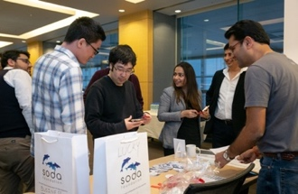
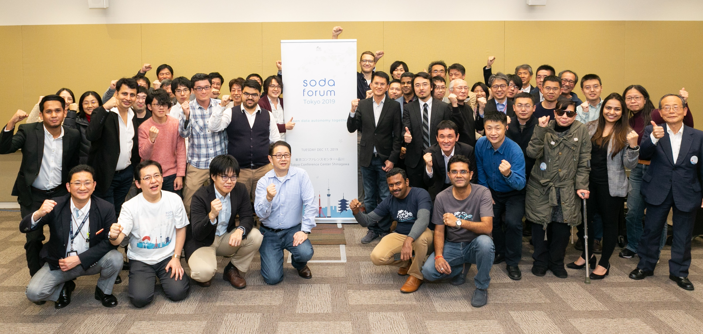
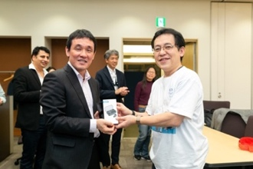
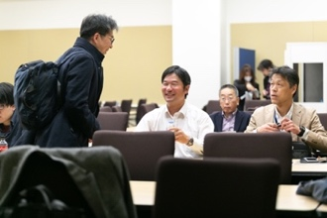
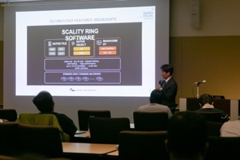
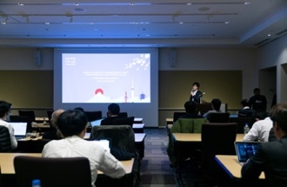
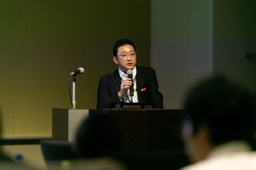
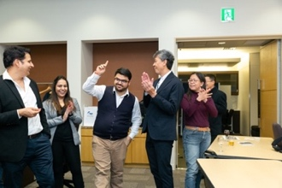
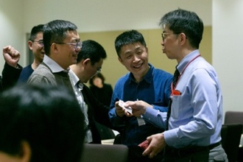
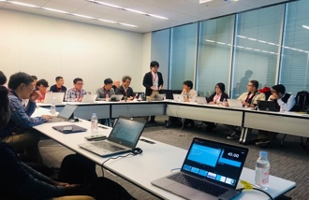
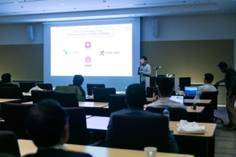
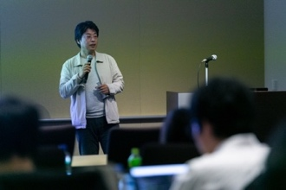

TOKYO CONFERENCE CENTER, SHINAGAWA. DEC 17, 2019
Representatives from over 25 organizations participated in the SODA Formation Meeting hosted by Sony at their Tokyo HQ. SODA Forum was at full house with presentations from Fujitsu, Huawei, Intel, NTT Coms, Scality, Sony, Toyota, Yahoo Japan, and other SODA members.
Soda forum + SODA FORMATION
Ecosystem Philosophy
SODA
ARM
AI for Data Infrastructure
Open Storage
Data Lakes for Big Data & AI

Slide 6
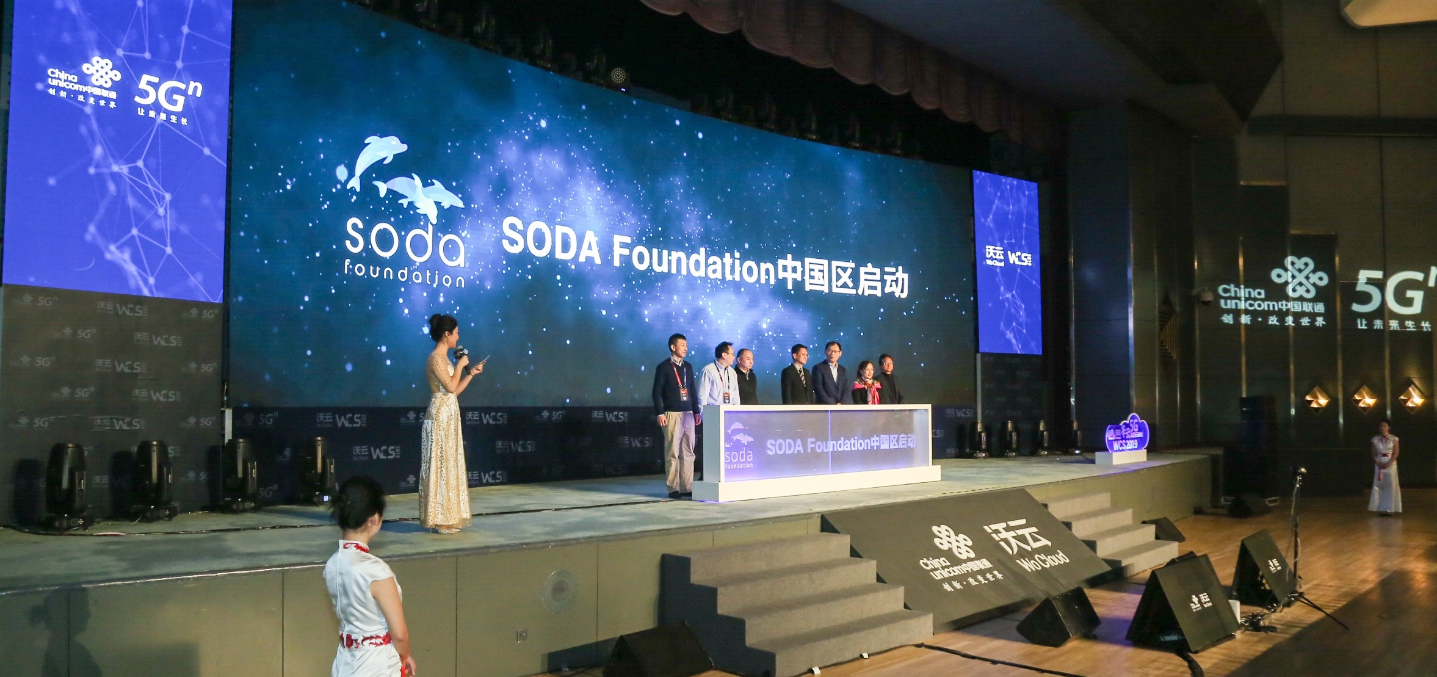
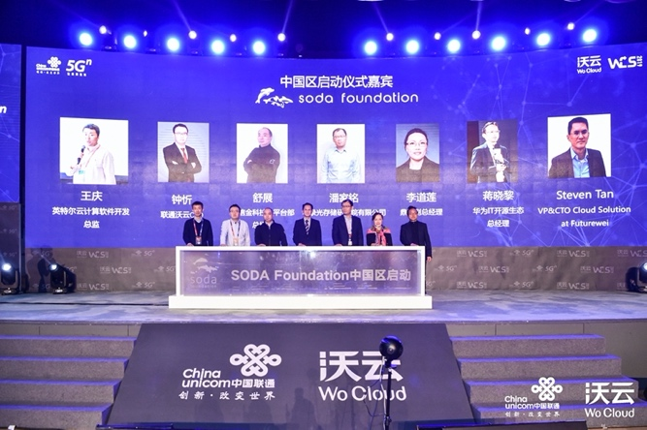
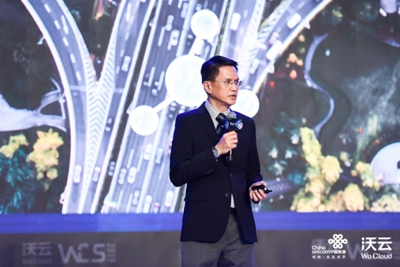
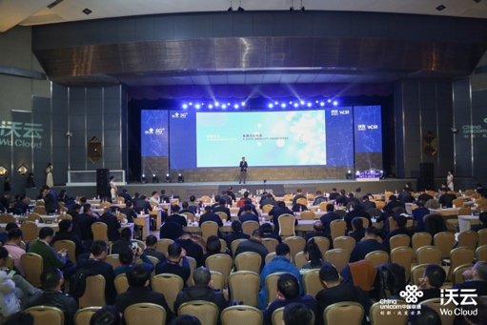
CHINA UNICOM WOCLOUD SUMMIT, BEIJING. DEC 20, 2019
SODA Foundation held its SODA China Community launch at the China Unicom WoCloud Summit with representatives from: China Unicom, China Construction Bank Fintech, eHualu, Huawei, Intel, and Scutech
SODA CHINA COMMUNITY LAUNCH
Ecosystem Philosophy
SODA
ARM
AI for Data Infrastructure
Open Storage
Data Lakes for Big Data & AI

